Slide 1
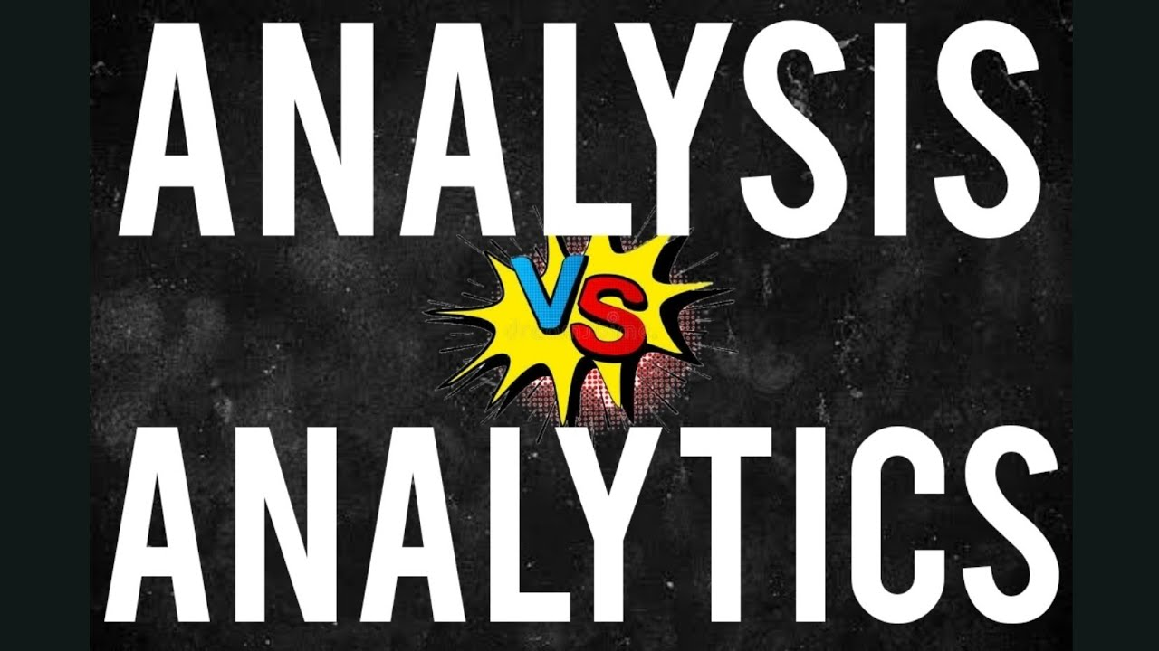

Slide 2


Analysis
Huge Data or Stored database.
Sample/small parts of data.

Slide 3

Past stored Data or already collected Data.

Slide 4
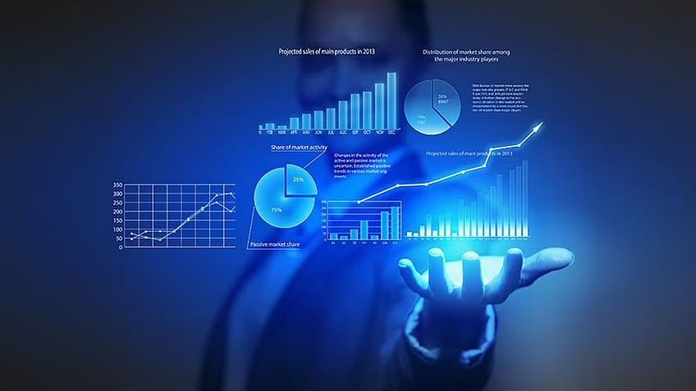
Analytics
Feature
Predicted data or Expected data.

Slide 5
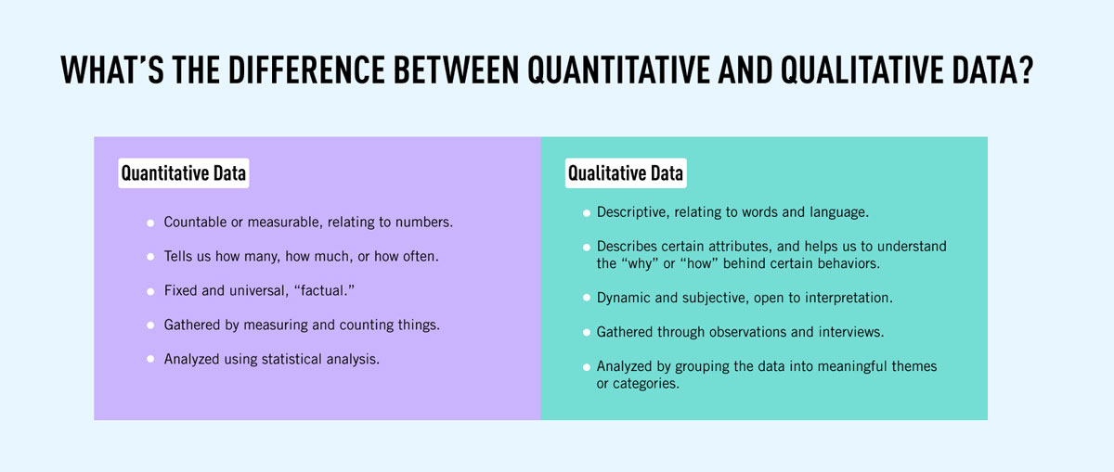

Slide 6
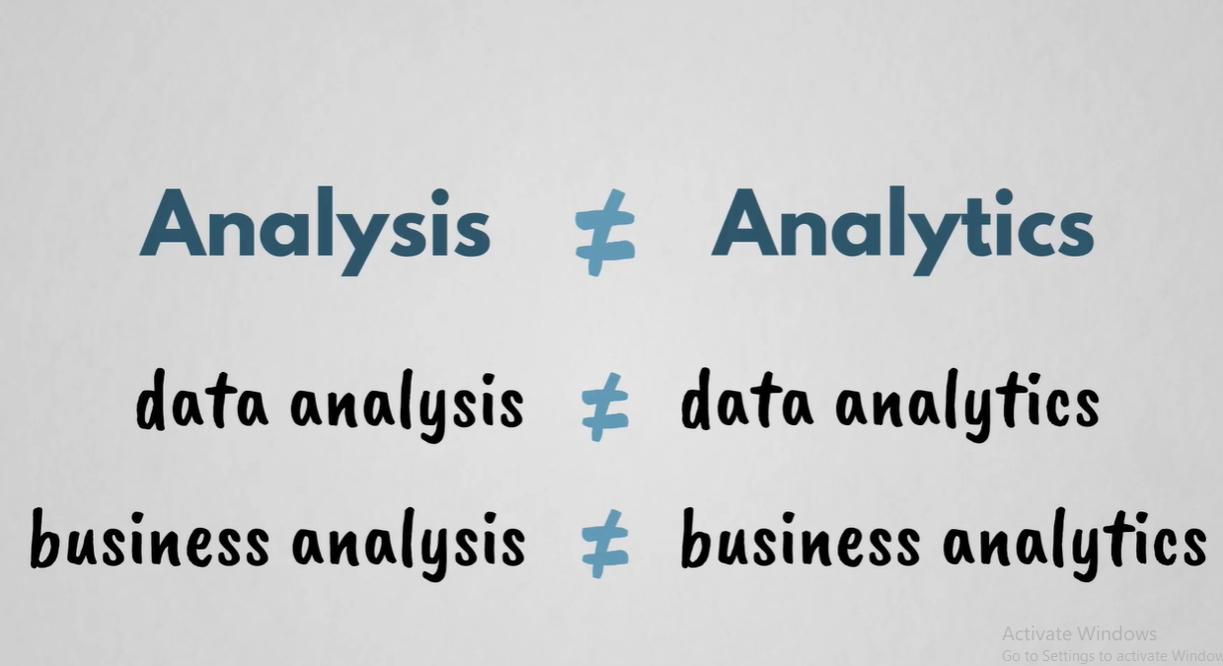

Slide 7
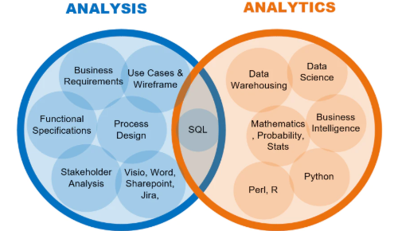

Slide 8


